Slide 1
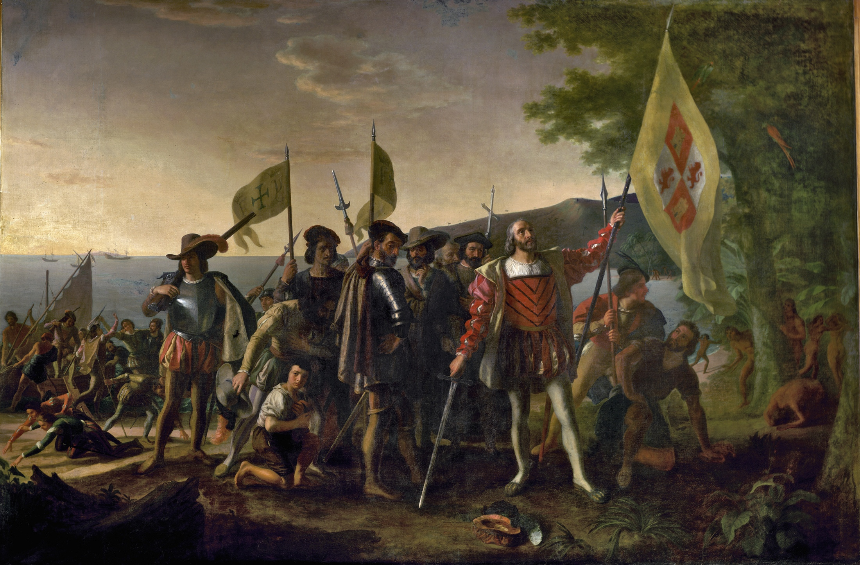
The Columbus Legend

Slide 2
Thinking Historically
Recall:
History is a personal interpretation of a selective view of the past.
Historians, like journalists, create a narrative based on their personal interests and assumptions.

Slide 3
History vs. Historiography
History: The chronological sequence of significant events from the past.
Historiography: The process of writing history. The writing of history based on the selection of particulars from authentic materials (i.e., primary sources) and the synthesis of these particulars into a narrative that will stand the test of time.

Slide 4
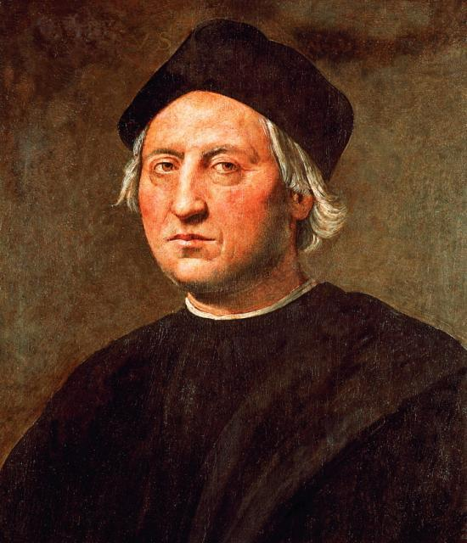
Columbus Brainstorm
In your journals, briefly respond to the following questions:
Who was Christopher Columbus?
What did he accomplish?

Slide 5
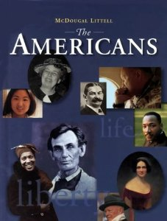
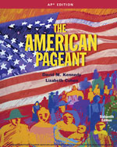
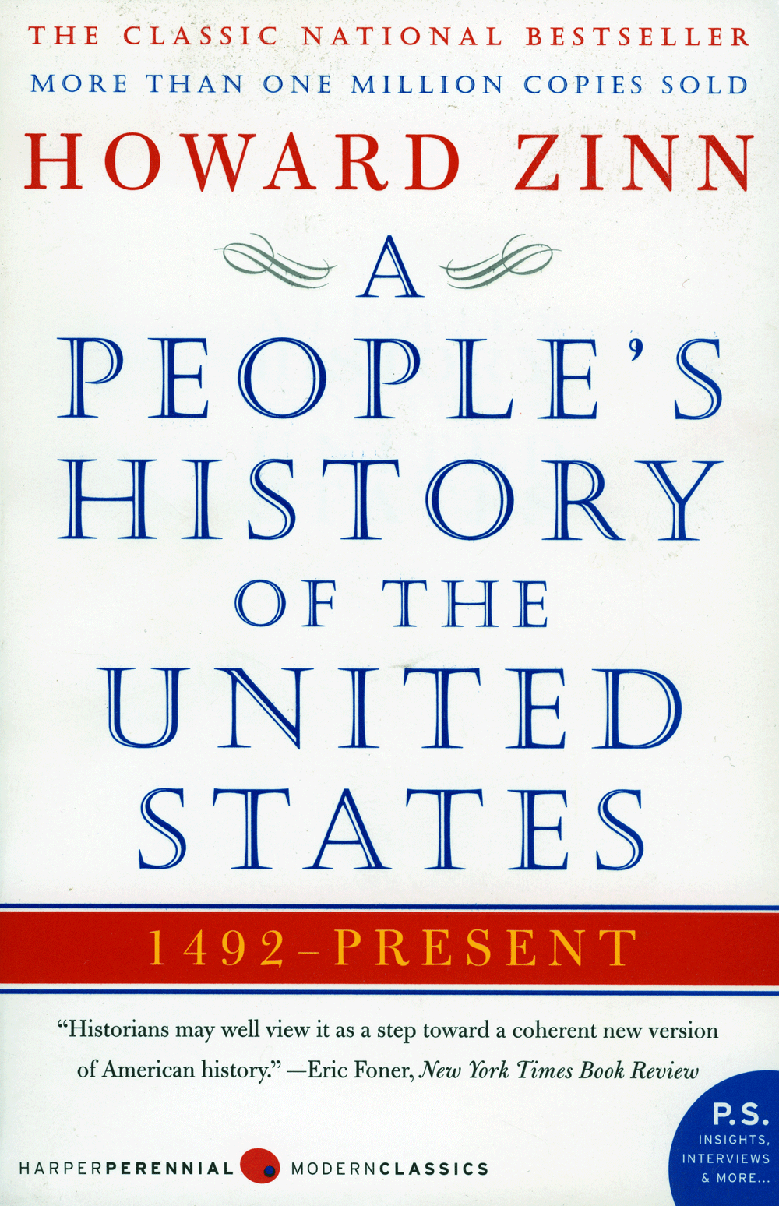
Analyzing the Columbus Legend
Step #1: Collecting Evidence, Close Reading & Note-Taking.
Annotate and take 2 pages of Cornell Notes on each of the following readings:
The Americans (your textbook), pp. 27-9.
The American Pageant (A.P. U.S. History text), pp. 14-5.
The People’s History of the United States (an alternative history text), pp. 1-12.

Slide 6
Analyzing the Columbus Legend
As you read and annotate these texts consider the following:
Argument: What does the author claim?
Evidence: What evidence is offered to support the author’s claims?
Purpose: What is the author’s goal? How does she want to make me feel? What does she want me to believe?
Diction: What words and phrases does the author use to present her account and persuade me she is right?
Selection: Which topics and types of evidence does the author use, and which are left out?

Slide 7
Analyzing the Columbus Legend
Note-Taking: Cornell Notes Format
Analysis Text
Comments
Critique
Questions
Analysis
Synthesis
Comparison
Summary/ Outline of Main Ideas

Slide 8
Analyzing the Columbus Legend
Step #2: Synthesis, Evaluation & Reflection
Respond to each of the following questions in 1 or more well-developed paragraphs per question:
1. How do the 3 accounts of the Columbus legend differ? How are they similar? Focus on:
** Topics Selected ** Claims Made
** Evidence Used ** Author’s Diction
Which of the 3 accounts is most credible? Why? Cite specific evidence to support your view.
How does Zinn’s version (People’s History) differ from those typically taught in elementary and middle schools? Why? What is Zinn asserting about the nature of historical writing on pages 8-10?
Due: Monday, September 25th.

